Slide 1
Non Numeric Data in R

Slide 2
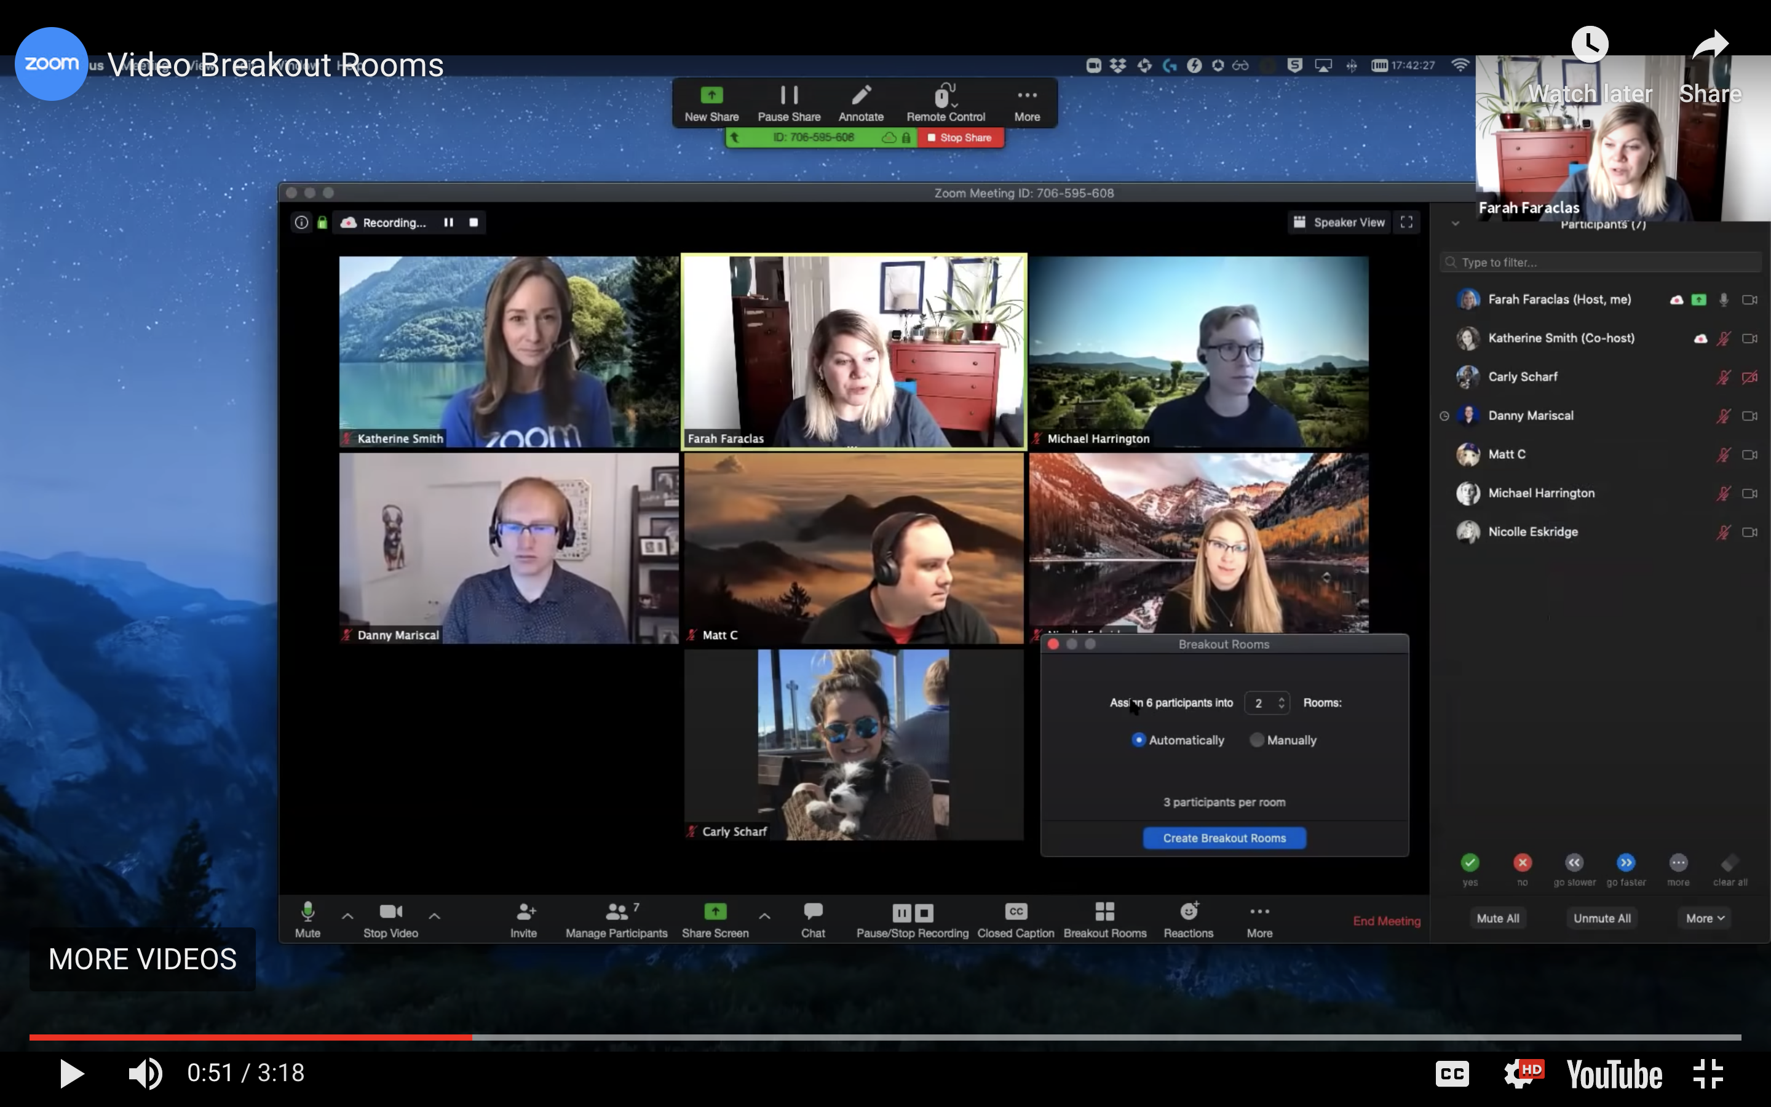
Exercise: What do you already know?
In the Chat Window type:
What types of non-numeric data do you need to work with / manipulate?
What functions / packages do you use to work with them?
Notes:
Split into group for this.

Slide 3

(Applied) Data Science
Visualize
Import
Tidy
Model
Communicate
Transform
Program
Notes:
At the start of the workshop I mentioned that there are only two packages in the Tidyverse that you really need to learn: dplyr and ggplot2. I also mentioned that dplyr is the main package for data transformation.
The caveat is that up until now we've only worked with numeric data. We've been asking questions like "How many babies were given a specific name in a specific year?" But there's a ton of non-numeric data that is useful to analyze, and today we'll be focusing on that.
This is analogous to how we approached importing data. "We can analyze data that is already in R. If we can learn to import data into R, then we can do so much more." Similarly, if we can learn to analyze non-numeric data, then we can do so much more (again!).

Slide 4
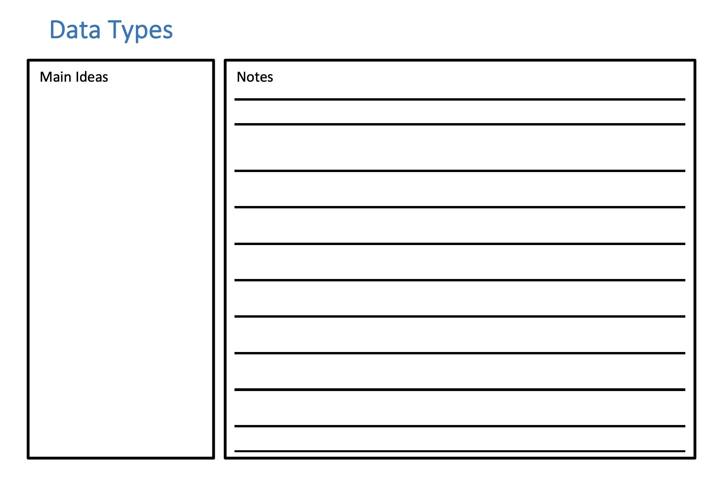
Notes Form
Please Take out

Slide 5
Open Non-Numeric-Data.Rmd

Slide 6
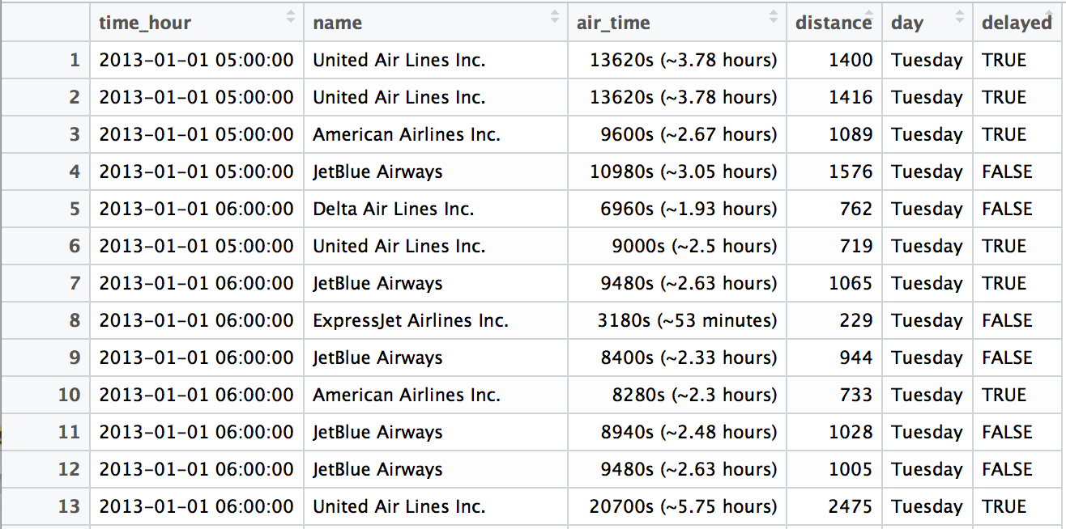
Quiz
What types of data are in this data set?
Notes:
Please put your answer in the chat

Slide 7
Non Numeric Data in R
Logical / Boolean
Character / String
Factor / Categorical
Dates and Times / POSIXct
Notes:
These are the 4 most important non-numeric data types that you're likely to encounter. We'll be covering each of them today. Each of these datatypes has multiple names, so I'm including a few of those names here.

Slide 8
Logicals
R's data type for boolean values (i.e. TRUE and FALSE).
typeof(TRUE)
## "logical"
typeof(FALSE)
## "logical"
typeof(c(TRUE, TRUE, FALSE))
## "logical"
Notes:
I often use "class" where Garrett uses "typeof"

Slide 9
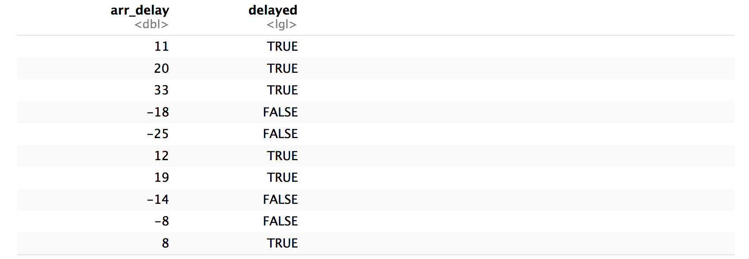
flights %>%
mutate(delayed = arr_delay > 0) %>%
select(arr_delay, delayed)
Notes:
This is an example of creating a logical value from an expression on another column. This is very common task.

Slide 10
flights %>%
mutate(delayed = arr_delay > 0) %>%
select(arr_delay, delayed)
Can we compute the proportion of NYC flights that arrived late?
Notes:
Take a moment to think about how you would answer this question.

Slide 11
Most useful skills
Math with logicals
Notes:
With logical data, there is really only one operation you need to know: how to do math with them.

Slide 12
Math
When you do math with logicals, TRUE becomes 1 and FALSE becomes 0.

Slide 13
Math
When you do math with logicals, TRUE becomes 1 and FALSE becomes 0.
The sum of a logical vector is the count of TRUEs
sum(c(TRUE, FALSE, TRUE, TRUE))
## 3

Slide 14
Math
When you do math with logicals, TRUE becomes 1 and FALSE becomes 0.
The sum of a logical vector is the count of TRUEs
sum(c(TRUE, FALSE, TRUE, TRUE))
## 3
The mean of a logical vector is the proportion of TRUEs
mean(c(1, 2, 3, 4) < 4)
## 0.75
Notes:
Perhaps demo
c(1, 2, 3, 4)
c(1, 2, 3, 4) < 4
mean(c(1, 2, 3, 4))

Slide 15
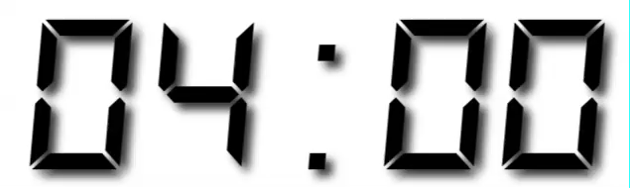
Your Turn 1
Use flights to create delayed, a variable that displays whether a flight was delayed (arr_delay > 0).
Then, remove all rows that contain an NA in delayed.
Finally, create a summary table that shows:
How many flights were delayed
What proportion of flights were delayed

Slide 16
flights %>%
mutate(delayed = arr_delay > 0) %>%
drop_na(delayed) %>%
summarise(total = sum(delayed), prop = mean(delayed))
## # A tibble: 1 × 2
## total prop
## <int> <dbl>
## 1 133004 0.4063101

Slide 17
Non Numeric Data in R
Logical / Boolean
Character / String
Factor / Categorical
Dates and Times
Notes:
There were only two operations we wanted to do with Logical values, and we were able to do them with base R. Now let's turn our attention to Strings.

Slide 18
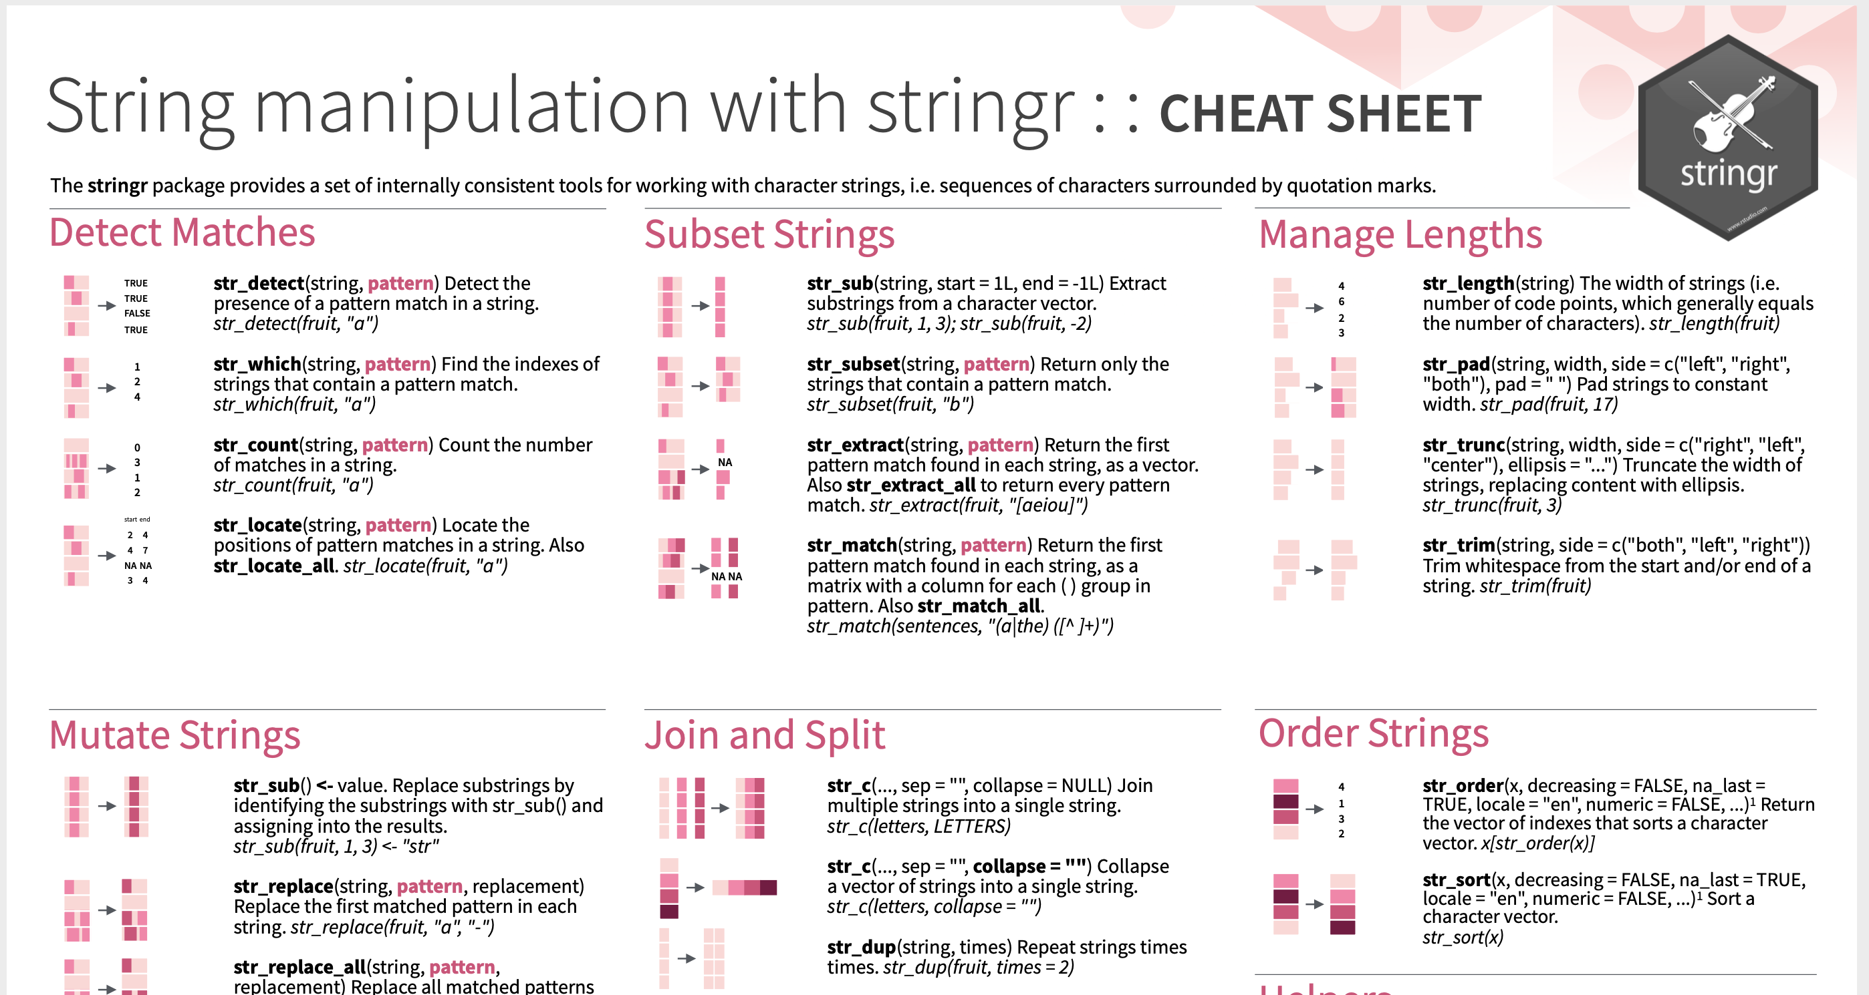
stringr Cheat Sheet
Please Take out
Notes:
Base R isn't great at working with strings. So we'll be using a separate package for it called stringr

Slide 19
(character) strings
Anything surrounded by quotes(") or single quotes(').
> "one"
> "1"
> "one’s"
> '"Hello World"'
> "foo
+
+
+ oops. I’m stuck in a string."

Slide 20

Warm Up
Type into the chat:
Are boys names or girls names more likely to end in a vowel?

Slide 21
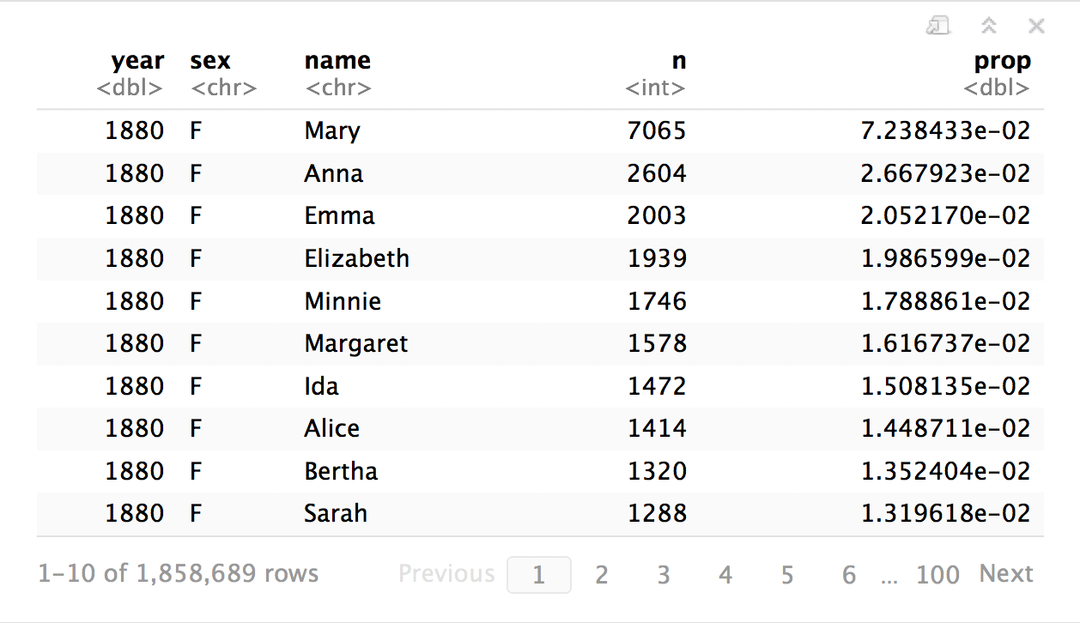

babynames
How can we build the proportion of boys and girls whose name ends in a vowel?

Slide 22
Most useful skills
How to extract/ replace substrings
How to find matches for patterns
Regular expressions

Slide 23
stringr
Simple, consistent functions for working with strings.
# install.packages("tidyverse")
library(stringr)
Notes:
You installed this package indirectly when you installed the Tidyverse

Slide 24
install.packages("tidyverse")
library("tidyverse")
does the equivalent of
does the equivalent of
install.packages("ggplot2")
install.packages("dplyr")
install.packages("tidyr")
install.packages("readr")
install.packages("purrr")
install.packages("tibble")
install.packages("stringr")
install.packages("hms")
install.packages("lubridate")
install.packages("stringr")
install.packages("forcats")
install.packages("DBI")
install.packages("haven")
install.packages("httr")
install.packages("jsonlite")
install.packages("readxl")
install.packages("rvest")
install.packages("xml2")
install.packages("modelr")
install.packages("broom")
library("ggplot2")
library("dplyr")
library("tidyr")
library("readr")
library("purrr")
library("tibble")
libraray("stringr")
Notes:
You also load it automatically once you type "library(tidyverse)"

Slide 25
str_sub()
Extract or replace portions of a string with str_sub()
str_sub(string, start = 1, end = -1)
string(s) to manipulate
position of first character to extract within each string
position of last character to extract within each string
Notes:
str_sub is the most popular function in the entire stringr package. Like all Tidyverse functions, the first parameter is the data you want to manipulate. But then you have 2 optional parameters, which specify the starting and stopping indices.
Let's now do a few short exercises to test your intuition of how str_sub works.

Slide 26
Quiz
What will this return?
str_sub("Garrett", 1, 2)

Slide 27
Quiz
What will this return?
str_sub("Garrett", 1, 2)
"Ga"
Notes:
Remember: R is unusual in that indexes start at 1.

Slide 28
Quiz
What will this return?
str_sub("Garrett", 1, 1)

Slide 29
Quiz
What will this return?
str_sub("Garrett", 1, 1)
"G"

Slide 30
Quiz
What will this return?
str_sub("Garrett", 2)
Notes:
This is a trick question. What happens when the 2nd position argument is missing?

Slide 31
Quiz
What will this return?
str_sub("Garrett", 2)
"arrett"

Slide 32
Quiz
What will this return?
str_sub("Garrett", -3)
Notes:
Another trick question. What happens when the first position argument is negative?

Slide 33
Quiz
What will this return?
str_sub("Garrett", -3)
"ett"

Slide 34
Quiz
What will this return?
g <- "Garrett"
str_sub(g, -3) <- "eth"
g
Notes:
Another trick: how does assignment work?

Slide 35
Quiz
What will this return?
g <- "Garrett"
str_sub(g, -3) <- "eth"
g
"Garreth"

Slide 36
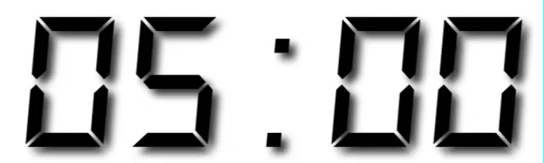
Your Turn 2
In your group, fill in the blanks to:
Isolate the last letter of every name
and create a logical variable that displays whether the last letter is one of "a", "e", "i", "o", "u", or "y".
Use a weighted mean to calculate the proportion of children whose name ends in a vowel (by year and sex).
and then display the results as a line plot.

Slide 37
babynames %>%
mutate(last = str_sub(name, -1),
vowel = last %in% c("a", "e", "i", "o", "u", "y")) %>%
group_by(year, sex) %>%
summarise(p_vowel = weighted.mean(vowel, n)) %>%
ggplot() +
geom_line(mapping = aes(year, p_vowel, color = sex))
Notes:
"color = sex" is a new aesthetic. It means that ggplot should create multiple lines: one for each unique value in the column. Here there are values for sex (M and F), so they are each get their own line, and each line gets its own color

Slide 38
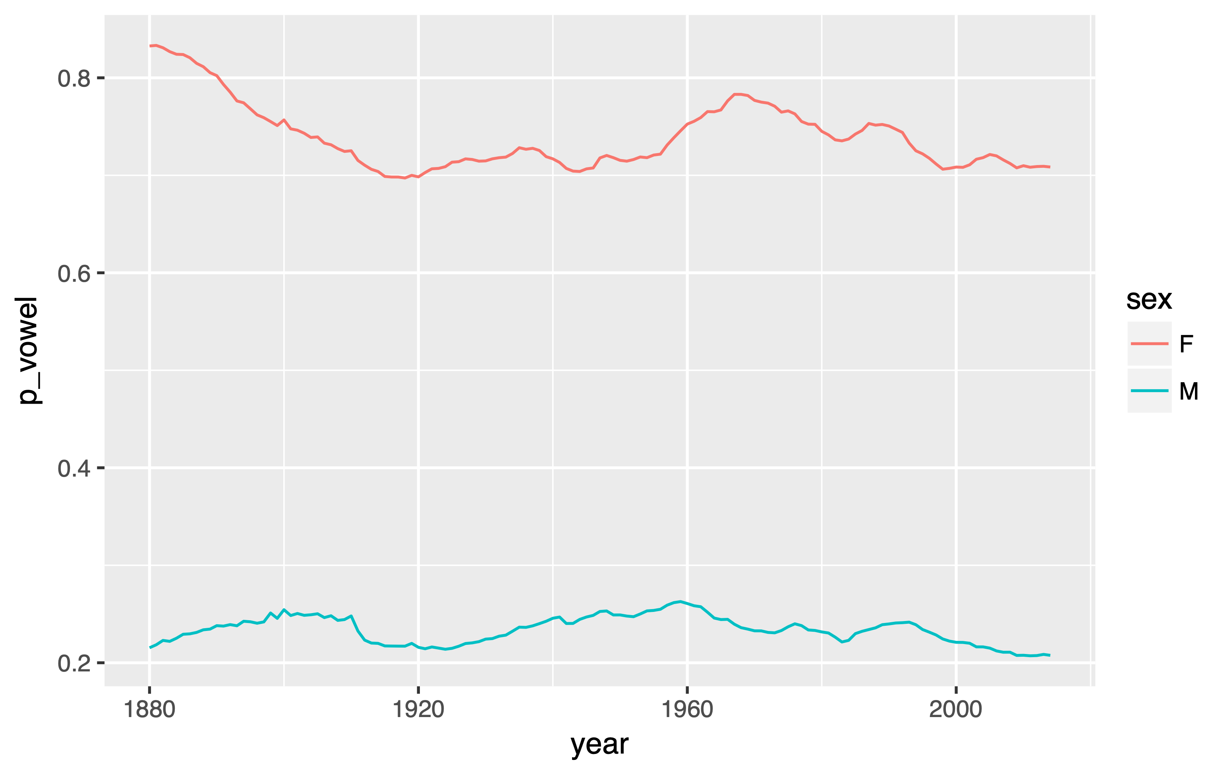
Proportion of names that end in a vowel

Slide 39
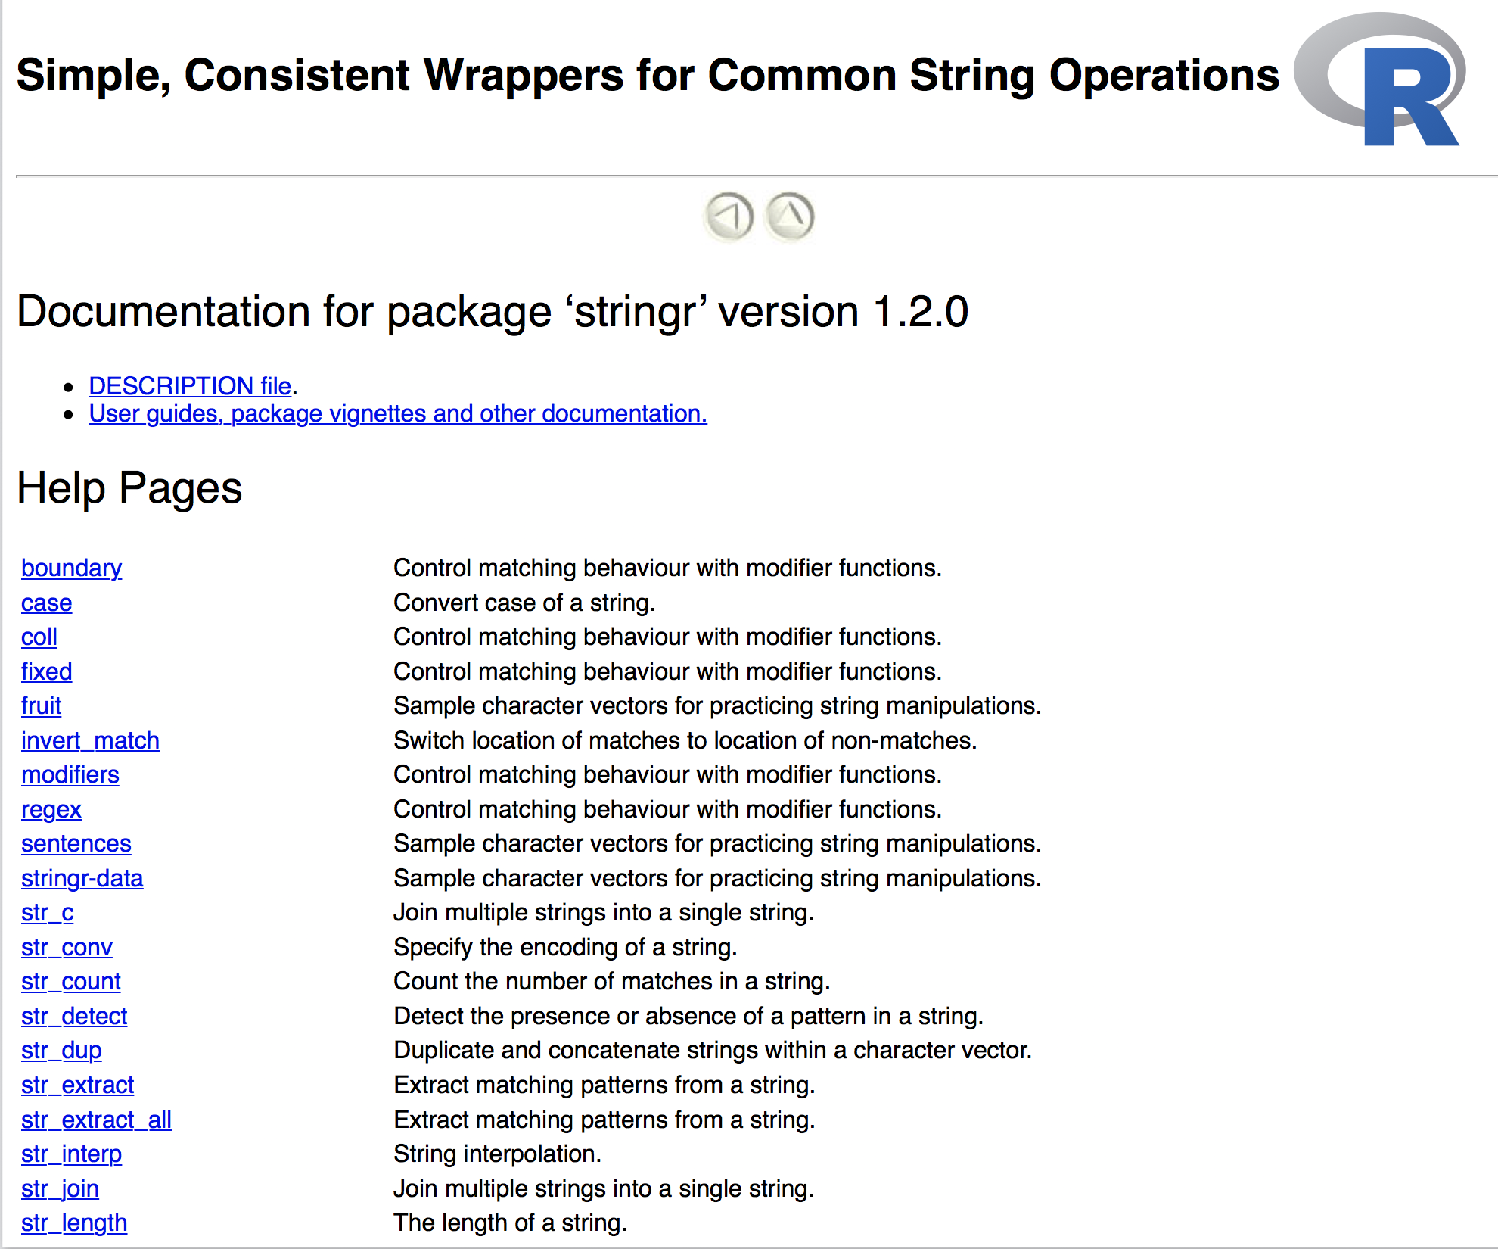
help(package = stringr)
Notes:
The stringr package contains a ton of functions. We won't get a chance to cover them all. Instead, I'd like to make sure that you're able to use the help for the package effectively. Bring up the help now, either by clicking on the package name in the RStudio window, or by typing "help(package=stringr)"

Slide 40
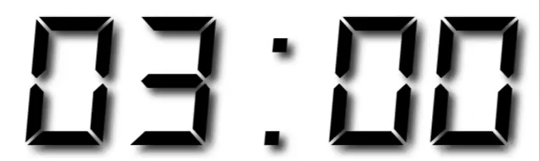
Your Turn
Run help(package = stringr) to open the help directory for stringr.
Read through the function descriptions and find the function that determines whether two strings match.
The first person in your group to find it wins!
Notes:
Garret says to type "help(package=stringr)". I recommend just finding stringr in the package pane, and clicking on it.

Slide 41
str_detect()
Test whether a pattern appears within a string.
str_detect(string, pattern)
vector of strings to find patterns in
a string that represents a regular expression
Notes:
This is the function that I hoped you would find. This function might work slightly differently than you'd expect, so let's go through a few examples.

Slide 42
Quiz
What will this return?
strings <- c("Apple", "Orange")
str_detect(strings, "pp")

Slide 43
Quiz
What will this return?
strings <- c("Apple", "Orange")
str_detect(strings, "pp")
TRUE FALSE

Slide 44
Quiz
What will this return?
strings <- c("Apple", "Pineapple")
str_detect(strings, "apple")

Slide 45
Quiz
What will this return?
strings <- c("Apple", "Pineapple")
str_detect(strings, "apple")
FALSE TRUE
Notes:
Case sensitive!

Slide 46
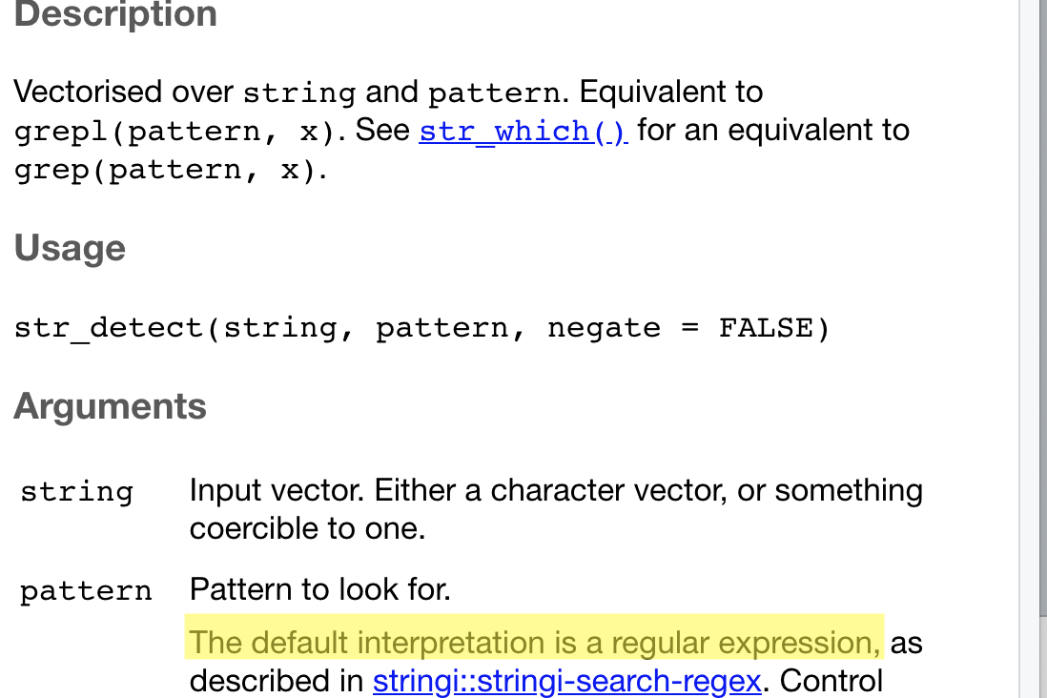
Regular Expressions
Advanced, flexible string detection
Notes:
When it comes to working with strings, something that you at least need to be aware of is Regular Expressions. Type into the chat window whether or not you've heard of Regular Expressions before. You can see here that the pattern defaults to being interpreted as a regular expression

Slide 47
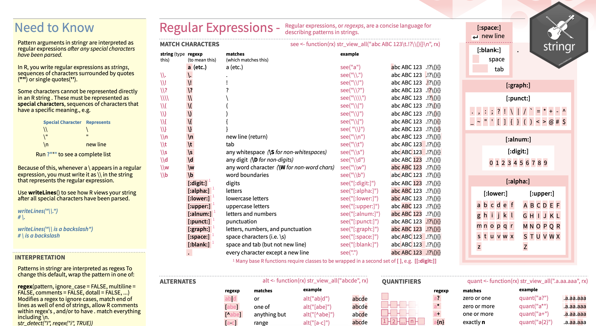
Regular Expressions
Advanced, flexible string detection Page 2 of Cheat Sheet
Notes:
Regular Expressions are a mini language that is designed to detect patterns in text. As you can imagine, using language to discuss language is complicated. You can google "Regular Expressions Cheat Sheet" and see tons of people have created tons of resources to help you learn them.

Slide 48
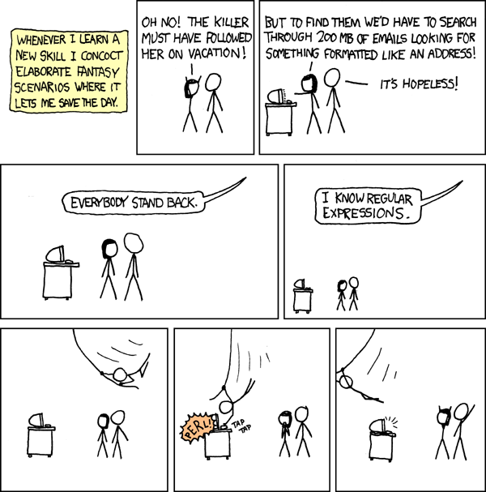
Notes:
The most famous joke about regular expressions ever. From the comic XKCD.

Slide 49

\w*[aeiouy]\b
Symbol | Meaning
\w | "word character"
* | "any number of"
[aeiouy] | "any character in between the []
\b | "word boundary"
Notes:
This is an example of a regular expression. It might be a bit scary - most regular expressions are.
QUIZ: What does this RegEx do?

Slide 50
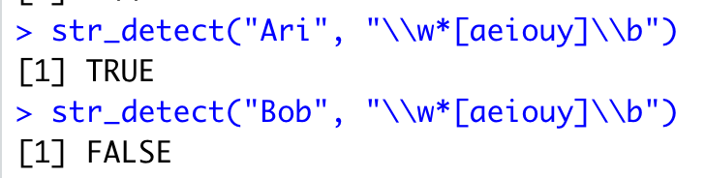
\ becomes \\
Notes:
If you give a regular expression to str_detect, all the back slashes need to be escaped. That is, each \ becomes \\. As you can see here, this Regular Expression "works". "Ari" ends in a vowel but "Bob" does not.

Slide 51
Your Turn
How many names end in a vowel anyways?
Winnow babynames to distinct names with:
babynames %>% distinct(name)
Use str_detect() to detect names that end in a vowel (pattern = "\\w*[aeiouy]\\b")
Calculate the number of names that end in a vowel

Slide 52
babynames %>%
distinct(name) %>%
mutate(vowel = str_detect(name, "\\w*[aeiouy]\\b")) %>%
summarise(n = n(), n_vowel = sum(vowel))
# A tibble: 1 × 2
n n_vowel
<int> <int>
1 97310 56945

Slide 53
hello@example.com
Create a RegEx for an email address... How hard can it be?
Notes:
Take a minute to try and solve this.

Slide 54
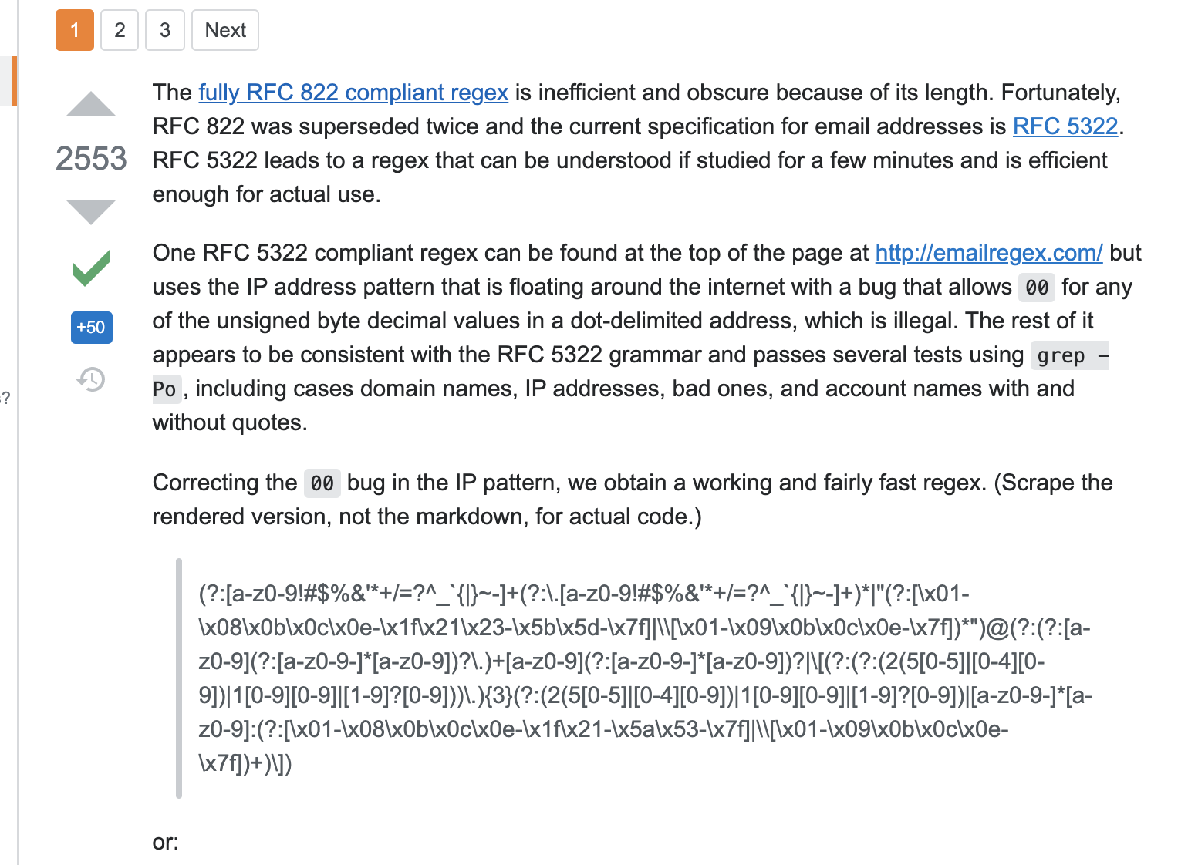
Not Human Readable

Slide 55

Tons of books on Reg Ex
Online tutorials and cheat sheets as well
Notes:
There might very well be a time when you need to use regular expressions for an advanced project. What I'd like you to leave here knowing is a few things.
The stringr package's str_detect function can help you detect patterns in strings using regular expressions.
You should expect to need to do a lot of testing of your pattern, to make sure that it handles all possible cases correctly.
There are a ton of resources devoted exclusively to this topic. Here I'm showing that on Amazon, there are over 300 books that return hits for Regular Expressions

Slide 56
Non Numeric Data in R
Logical / Boolean
Character / String
Factor / Categorical
Dates and Times
Notes:
Now lets talk about factors (categorical data), and how the Tidyverse can make it easier for you to work with them.

Slide 57
factors
R’s representation of categorical data. Consists of:
A set of values
An ordered set of valid levels
eyes <- factor(x = c("blue", "green", "green"),
levels = c("blue", "brown", "green"))
eyes
## [1] blue green green
## Levels: blue brown green
Notes:
Even though "brown" is not in the data, it's still a possible value

Slide 58
factors
Stored as an integer vector with a levels attribute
unclass(eyes)
## 1 3 3
## attr(,"levels")
## "blue" "brown" "green"
Notes:
Factors are stored as integers. And you can see here that "blue green green" is really, internally, "1 3 3".
This impacts how factors behave when you sort them.

Slide 59
Quiz Sorting Character Data
What will this return?
possible_values = c("low", "normal", "high")
sort(possible_values)
Notes:
Imagine recording (and sorting) medical data in character form. Say blood pressure levels, which can be either low, normal or high.

Slide 60
Quiz Sorting Character Data
What will this return?
possible_values = c("low", "normal", "high")
sort(possible_values)
[1] "high" "low" "normal"
Notes:
Character data is sorted in alphabetical order (low to high). Sometimes this is what you want. And sometimes (like in this case) it isn't.

Slide 61
Quiz Sorting Factor Data
What will this return?
possible_values = c("low", "normal", "high")
recorded_values = c("low", "low", "normal", "high")
f = factor(x = recorded_values,
levels = possible_values)
sort(f)
Notes:
How will the data sort when the data is a factor?

Slide 62
Quiz Sorting Factor Data
possible_values = c("low", "normal", "high")
recorded_values = c("low", "low", "normal", "high")
f = factor(recorded_values,
levels = possible_values)
sort(f)
[1] low low normal high
Levels: low normal high
Notes:
factor data is sorted by its levels

Slide 63
Quiz
Should "day" be a factor or character?
Notes:
Remember this slide? Should "day" be a factor or a character? What are the pros and cons of this decision?

Slide 64
Non Numeric Data in R
Logical / Boolean
Character / String
Factor / Categorical
Dates and Times
Notes:
We're now coming to one of the most complex data types known to mankind: Dates and Times. If you don't believe me that they are unbelievably complex, you will soon.

Slide 65
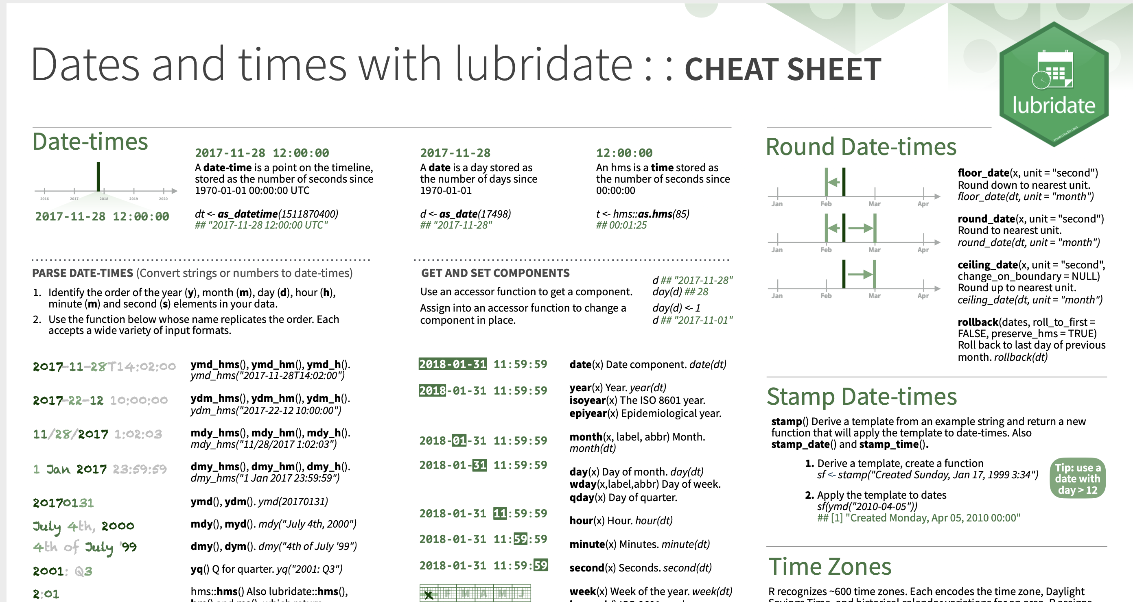
lubridate Cheat Sheet
Please take out

Slide 66
Quiz
Does every year have 365 days?
Notes:
The complexity with date-times is that you have to cover every possible case ahead of time. Consider these examples that show you how many edge cases there are.
Leap Years

Slide 67
Quiz
Does every day have 24 hours?
Notes:
Daylight Savings Time. Imagine writing a billing system where someone bills by the hour ... and then the clock either skips ahead or moves back and hour!

Slide 68
Quiz
Does every minute have 60 seconds?
Notes:
Google "Leap Second"

Slide 69
Quiz
What does a month measure?
Notes:
30 days has September. How can you measure something in "months" when a "month" isn't consistent?

Slide 70
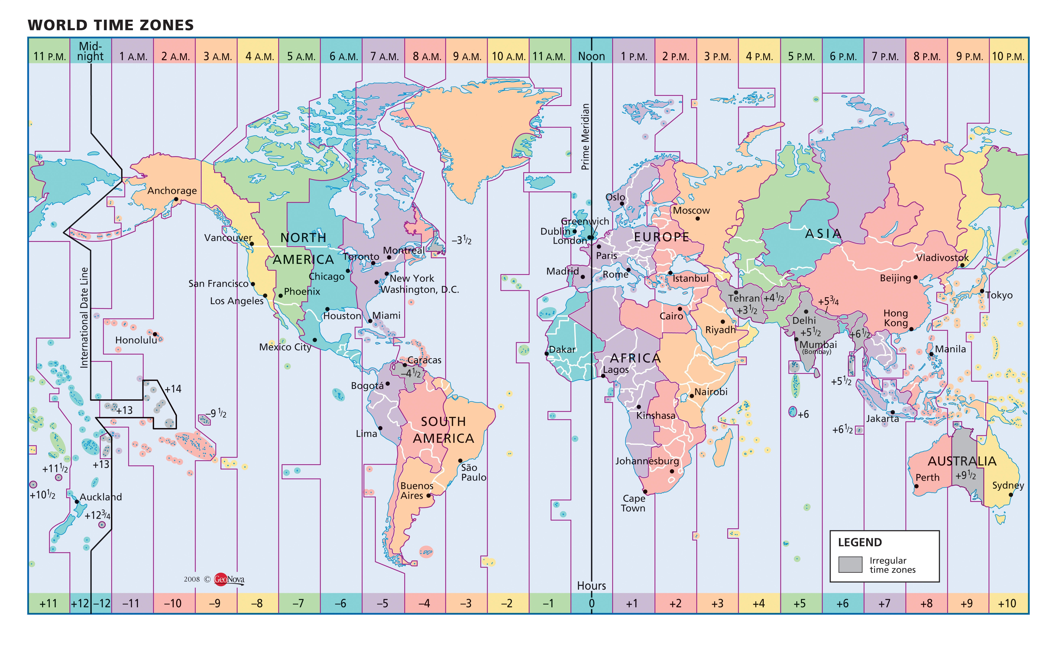
Notes:
This is how Time Zones are laid out. It shows just how big a difference there is between the actual math and rules of dates and times and how we experience it on a day-to-day basis. Note how the international date line moves to accomodate the border between Alaska and Russia.

Slide 71

Dates and times involve:
instants - specific moments in time (e.g., Jan 1, 2017)
time spans - spans of time (e.g., a day)
Notes:
For instants, think of timestamps in a database - This email went out at this time.
For time spans, think of a service that bills by the hour - The lawyer spent 2 hours in court.

Slide 72
Most useful skills
Creating dates/times (i.e. parsing)
Access and change parts of a date
Notes:
I actually recently helped someone with these exact problems during an Office Hours session. The had a bunch of dates, and wanted to strip the day components out of all of them, so you just had the equivalent of "January 2020" instead of "January 1, 2020", "January 2, 2020", etc. You can't actually remove the day portion of a date in R, but we were able to shift all the days to be "1", which accomplished the same thing.

Slide 73
Warm Up
Decide in your group:
What is the best day of the week to fly?
Notes:
We're going to be going back to the nycflights database for this problem. Take a minute to think about the answer to this question.

Slide 74
Creating dates
and times
Notes:
Before diving into the tidyverse packages for dealing with dates and times, let's look at the classes that Base R provides.

Slide 75
(some of) R’s instant classes
2017-01-01 12:34:56
Notes:
Let's start by reviewing two classes R has for working with points in time ("instants").

Slide 76
POSIXct
2017-01-01 12:34:56
Stored as the number of seconds since 1970-01-01 00:00:00
Sys.time()
## "2017-01-01 12:34:56 EST"
unclass(Sys.time())
## 1483292096
Notes:
Unix Standard Epoch

Slide 77
Dates
2017-01-01 12:34:56
Stored as the number of days since 1970-01-01
Sys.Date()
## "2017-01-01"
unclass(Sys.Date())
## 17167

Slide 78
lubridate
Functions for working with dates and time spans
# install.packages("tidyverse")
library(lubridate)
Notes:
This package used to not be loaded automatically when the tidyverse loads. But now I believe that it is.

Slide 79
ymd() family
To parse strings as dates, use a y, m, d, h, m, s combo
ymd("2017/01/11")
mdy("January 11, 2017")
ymd_hms("2017-01-11 01:30:55")
Notes:
y = year, m = month, d = day
Note that the second one is mdy, not ydm.
The third has hms

Slide 80
Parsing functions
function | parses to
ymd_hms(), ymd_hm(), ymd_h()
ydm_hms(), ydm_hm(), ydm_h() | POSIXct
dmy_hms(), dmy_hm(), dmy_h()
mdy_hms(), mdy_hm(), mdy_h()
ymd(), ydm(), mdy() | Date (POSIXct if tz specified)
myd(), dmy(), dym(), yq()
hms(), hm(), ms() | Period
Notes:
All possible variations!

Slide 81
ymd() family
To parse strings as dates, use a y, m, d, h, m, s combo
ymd_hms("2017-01-01T12:34:56")
## "2017-01-01 12:34:56 UTC"
ymd_hm("2017/01/01 12:34")
## "2017-01-01 12:34:56 UTC"
dmy("2 January 17")
## "2017-01-02"
ms("34 56")
## "34M 56S"
lubridate functions are separator agnostic

Slide 82
Accessing
and changing components
Notes:
That's everything I have to say about parsing dates. Now let's look at accessing and changing components of a datetime object

Slide 83
Accessing components
Extract components by name with a singular name
date <- ymd("2017-01-11")
year(date)
## 2017

Slide 84
Setting components
Use the same function to set components
date
## "2017-01-11"
year(date) <- 1999
date
## "1999-01-11"
Notes:
This is something that's very unique in R.

Slide 85
Accessing date time components
function | extracts | extra arguments
year() | year
month() | month | label = FALSE, abbr = TRUE
week() | week
day() | day of month
wday() | day of week | label = FALSE, abbr = TRUE
qday() | day of quarter
yday() | day of year
hour() | hour
minute() | minute
second() | second
Notes:
All functions for getting/setting components of a datetime

Slide 86
Accessing components
wday(ymd("2017-01-11"))
## 4
wday(ymd("2017-01-11"), label = TRUE)
## [1] Wed
## 7 Levels: Sun < Mon < Tues < Wed < Thurs < ... < Sat
wday(ymd("2017-01-11"), label = TRUE, abbr = FALSE)
## [1] Wednesday
## 7 Levels: Sunday < Monday < Tuesday < ... < Saturday

Slide 87
Your Turn 6
Fill in the blanks to:
Extract the day of the week of each flight (as a full name) from time_hour.
Calculate the average arr_delay by day of the week.
Plot the results as a column chart (bar chart) with geom_col().
Notes:
Use geom_col() (not geom_bar()).
-geom_col assumes you are telling it the height of the bar
-geom_bar assumes you are giving it a lot of rows, and asking it to do the counting for you

Slide 88
flights %>%
mutate(weekday = wday(time_hour, label = TRUE, abbr = FALSE)) %>%
group_by(weekday) %>%
drop_na(arr_delay) %>%
summarise(avg_delay = mean(arr_delay)) %>%
ggplot() +
geom_col(mapping = aes(x = weekday, y = avg_delay))

Slide 89
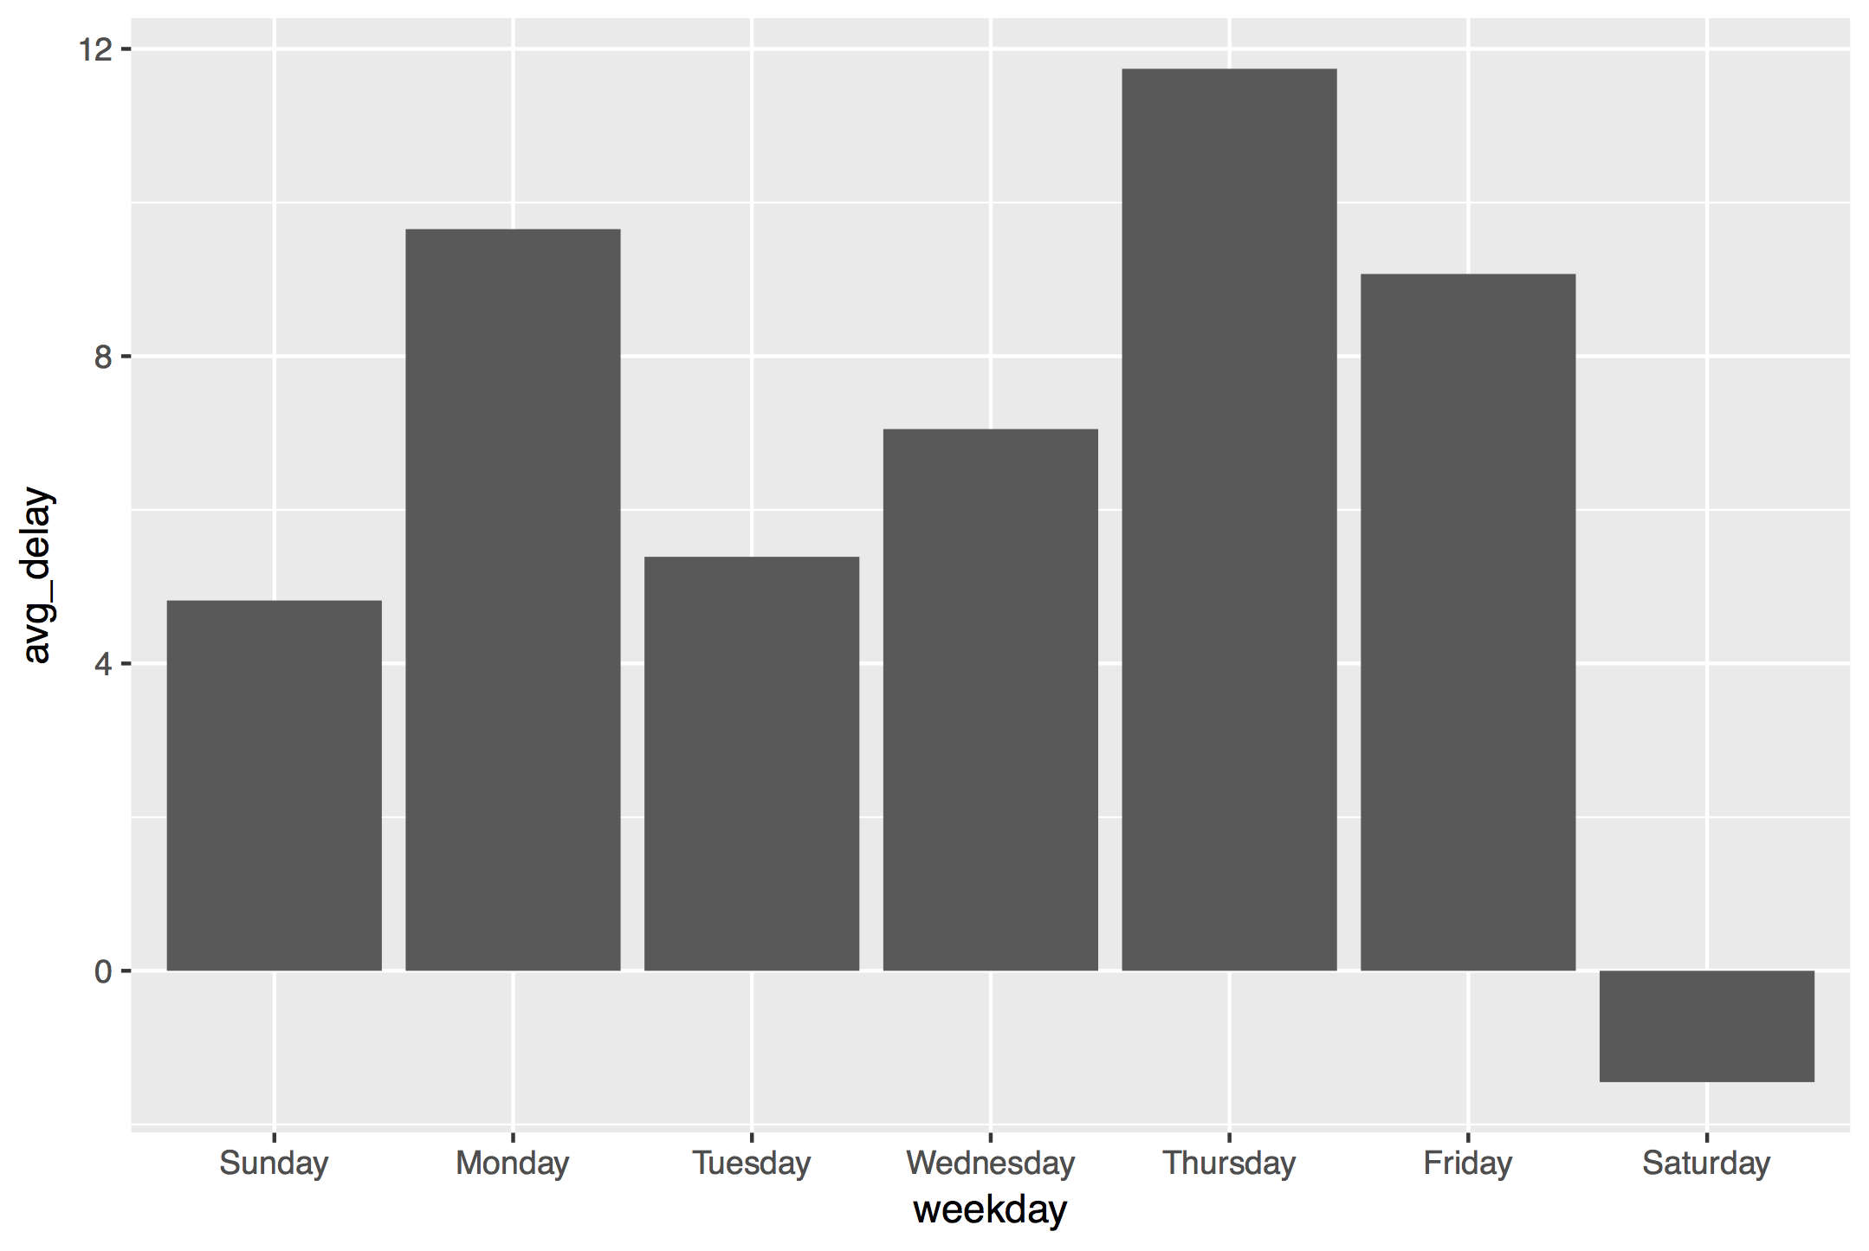

Slide 90
Non Numeric Data in R
Logical / Boolean
Character / String (use the stringr package)
Factor / Categorical
Dates and Times (use the lubridate package)
Notes:
That concludes everything I wanted to say about how working with non-numeric data. As a reminder, logical/boolean data comes up all the time, and you can use base R for that. I expect that you will regularly have to work with string (character) and date data. And stringr and lubridate really do make those tasks easier. I expect that manipulating factors is something you'll need to do rarely.

Slide 91
Notes Form
Please Take out
Notes:
I'd now like to give you a minute to write down any thoughts you have about what you just learned, including any questions or things you'd like to follow up on

